Slide 1
Diane Stover
Is Planned Parenthood in Your School?
Program Director, Protect Ohio Children Coalition

Slide 2
Is Planned Parenthood in Your School?
This workshop will help you
identify the warning signs
and give parents and activists
the best techniques for exposing
them in your community.

Slide 3
International Planned Parenthood promotes the idea that abortion can be a safe and positive choice. They often convey to children that they have the right to access both abortion services and contraceptives, sometimes directing them to abortion providers. This approach can find its way into classrooms through Comprehensive Sex Education (CSE) and Social Emotional Learning (SEL) programs.

Slide 5
Social Emotional Learning(SEL)
Whole Child Framework

Slide 6
Kathy Boff
Protect Ohio Children Coalition

Slide 7
Erin’s Law

Slide 11
Comprehensive Sex Education – 7-12 Planned Parenthood

Slide 12
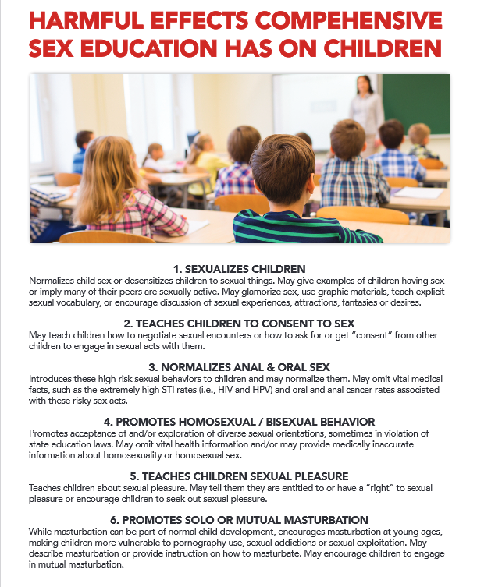
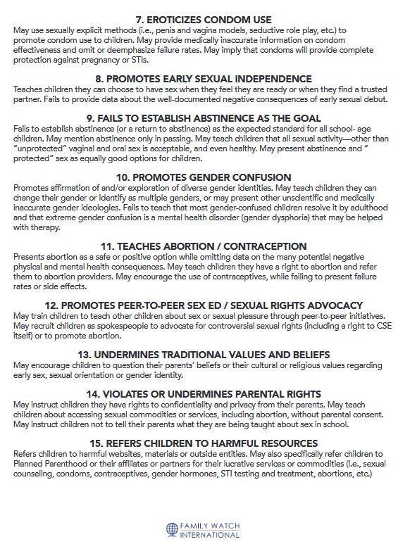

Slide 13
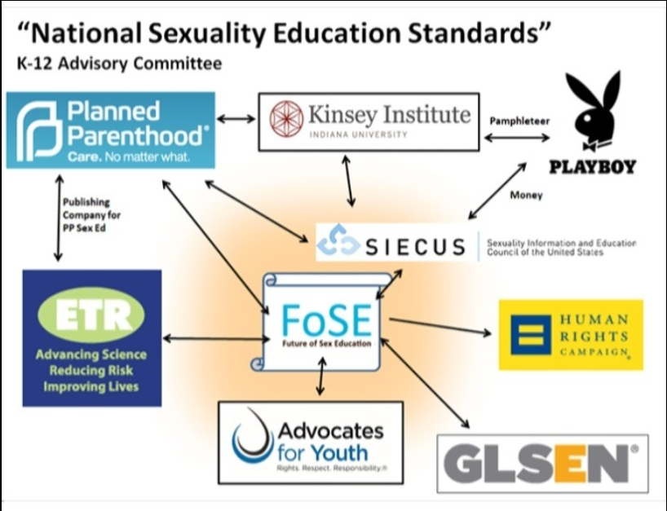
Future of Sex
Education =
FoSE

Slide 15
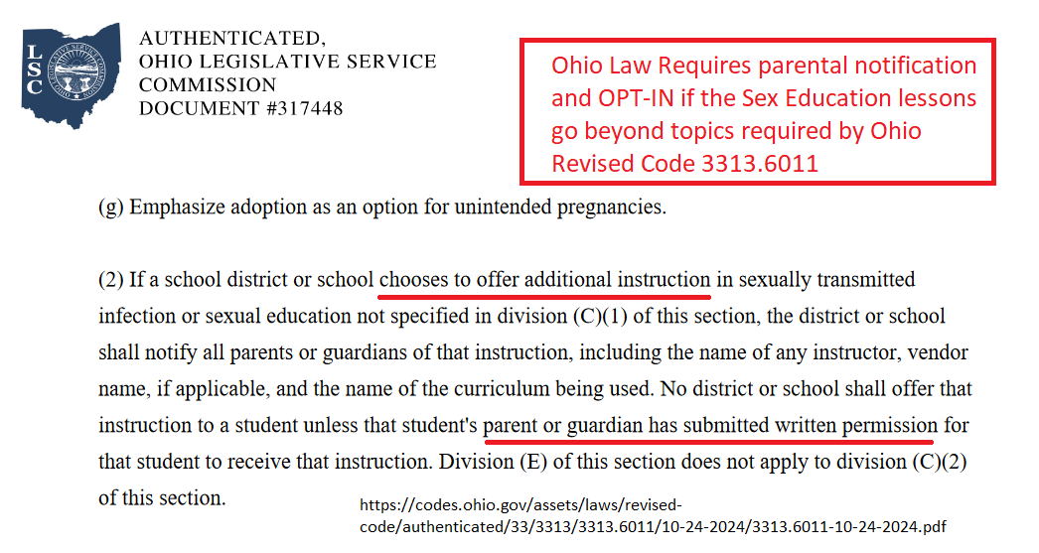
Ohio Revised Code 3313.6011

Slide 16
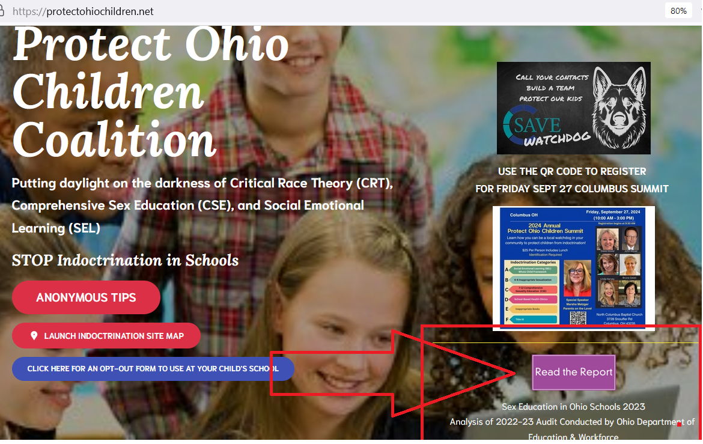
ODE annual sex ed audit

Slide 17
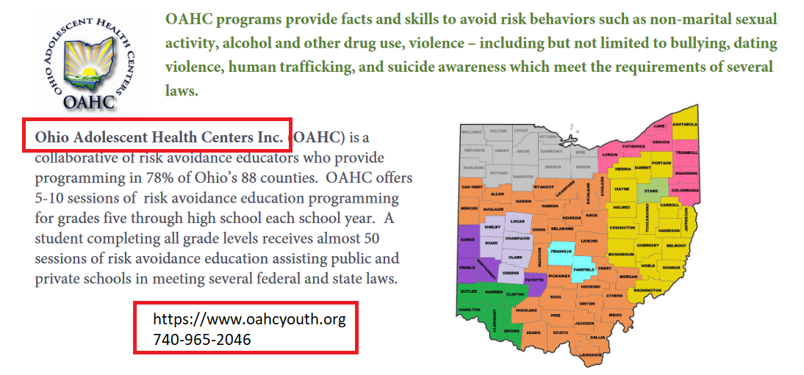
Programs in Compliance with ORR

Slide 18
Gail Larrow
Protect Ohio Children Coalition

Slide 19
What is it? School-Based Health Centers (Ohio)
Gov. DeWine—approved $25.9 million for SBHC in 2022
Created 22 new SBHC and expands 107 current SBHC
Appalachian Children’s Health Initiative 2024-25
$7.5 million for 20 Ohio Counties
Ohio Law – “Parents Bill of Rights” needs to be amended
ORC 5122.04 – Children 14 and older can meet with a mental health therapist without consent
6 sessions or 30 days

Slide 20
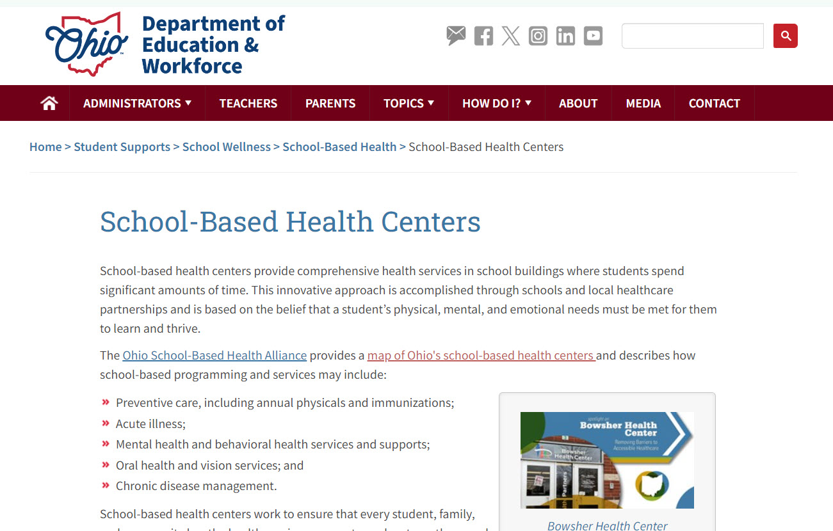

Slide 21
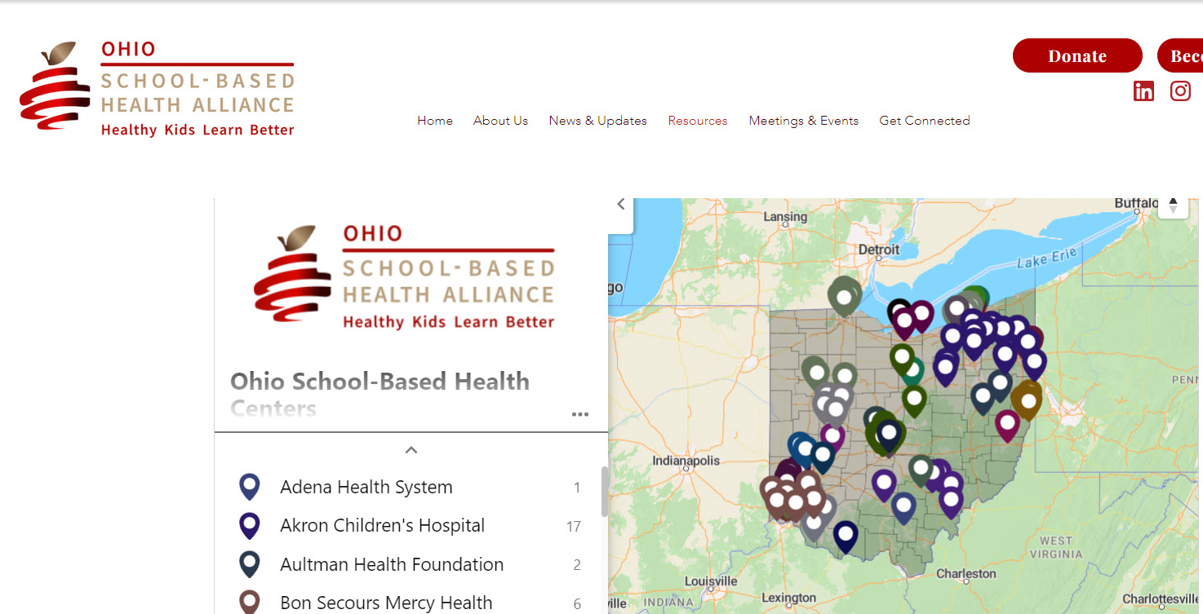
Map of School Based Health Clinics

Slide 22
Bruna Galati
Protect Ohio Children Coalition

Slide 23
STOP Inappropriate Books
What can you do?
Send a FOIA email to the school board requesting searchable MS Excel files of school library books.
Research books in your school district’s library (booklooks.org)
Gather the community together for support
Speak at a board meeting providing them with a list of inappropriate books
Ask about the process of reviewing inappropriate books
Provide this list of inappropriate books to the mayor and councilmen
Follow up for compliance
Report teachers to Dept of Education and Workforce
Work with Ohio State Representative or Senator to follow up with HB 556 reassignment in 2025
You have the power!
You can do it!

Slide 24
John Stover
President, Ohio Value Voters

Slide 25
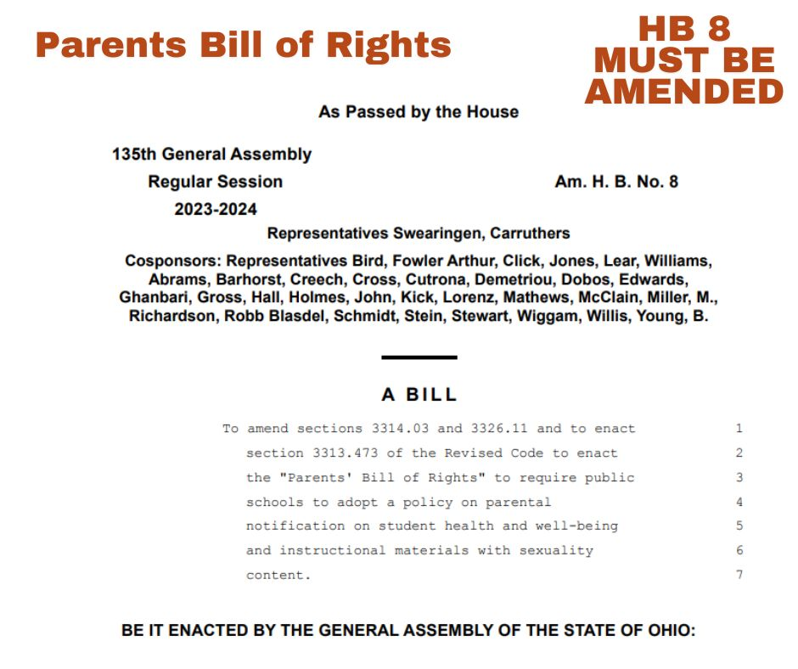

Slide 26
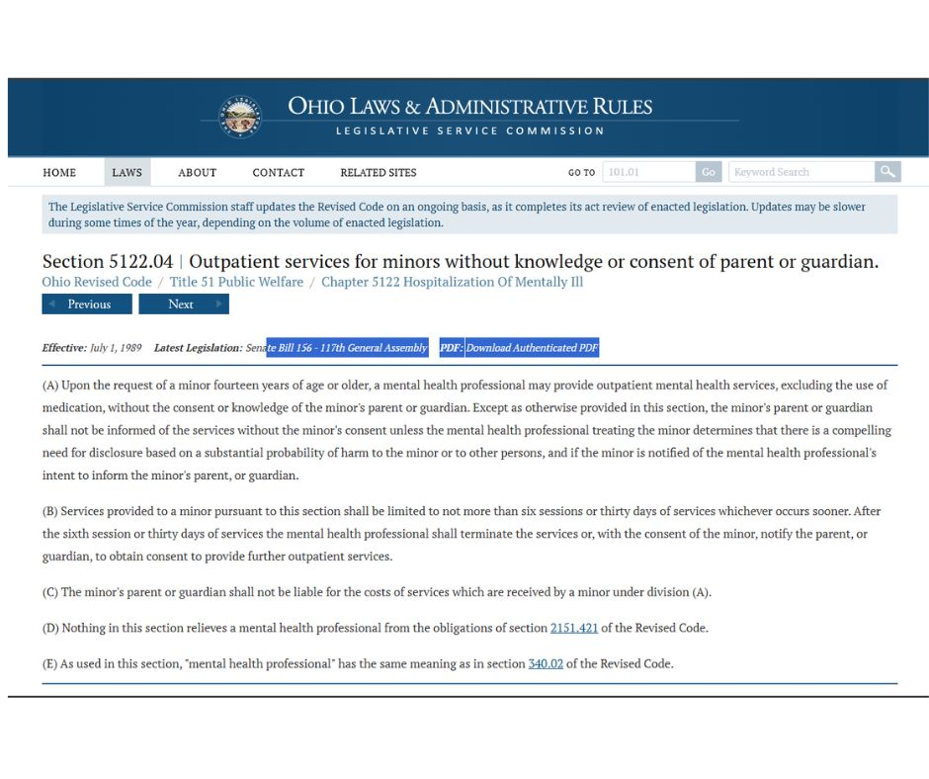

Slide 27
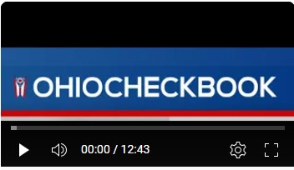
HB 491 “Provide information on expenditures to the
Ohio Checkbook”
WATCH OUR OHIO CHECKBOOK TUTORIAL ON PROTECT OHIO CHILDREN YOUTUBE

Slide 28
Q&A

