Slide 1
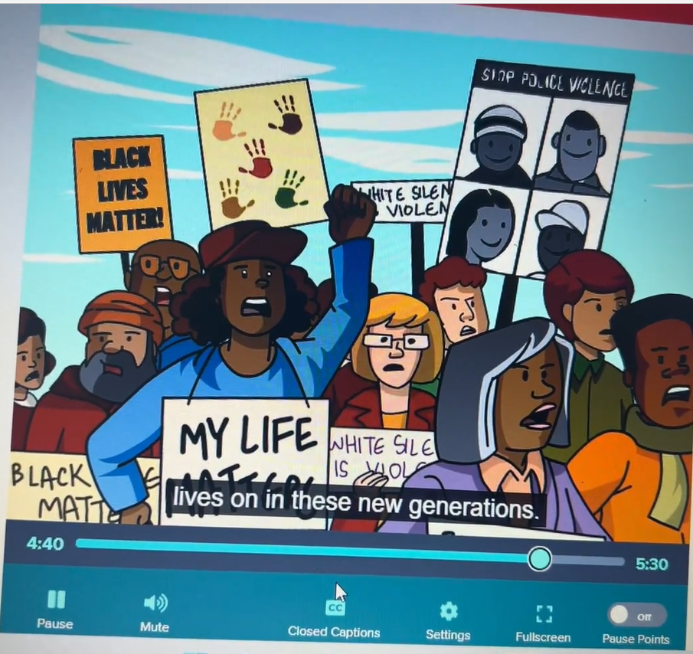
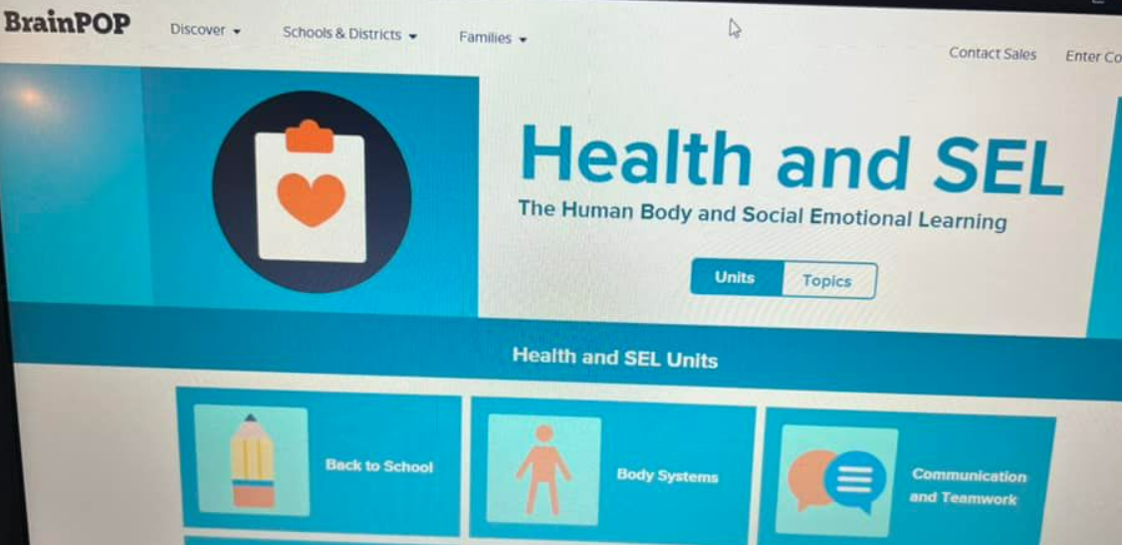
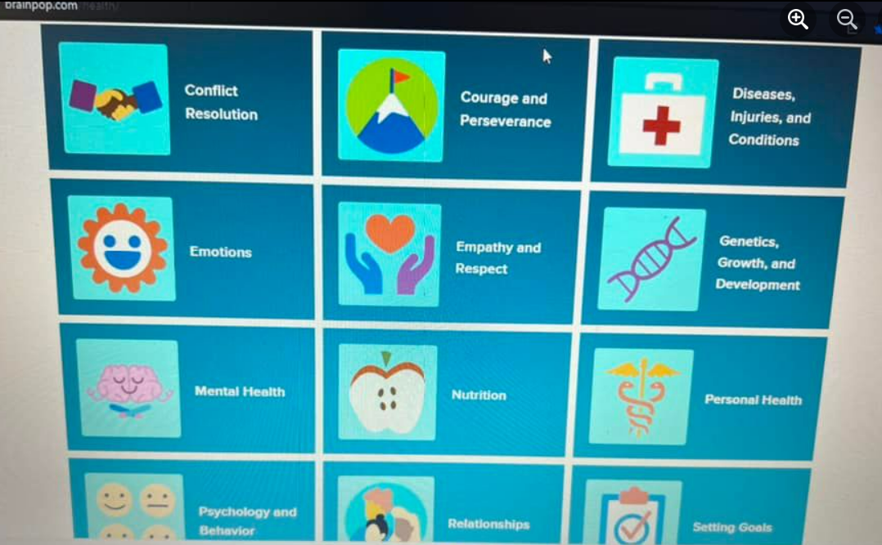
Lake 8th Grade Health Class. Brain Pop is used for multiple classes.
(2) Facebook

Slide 2
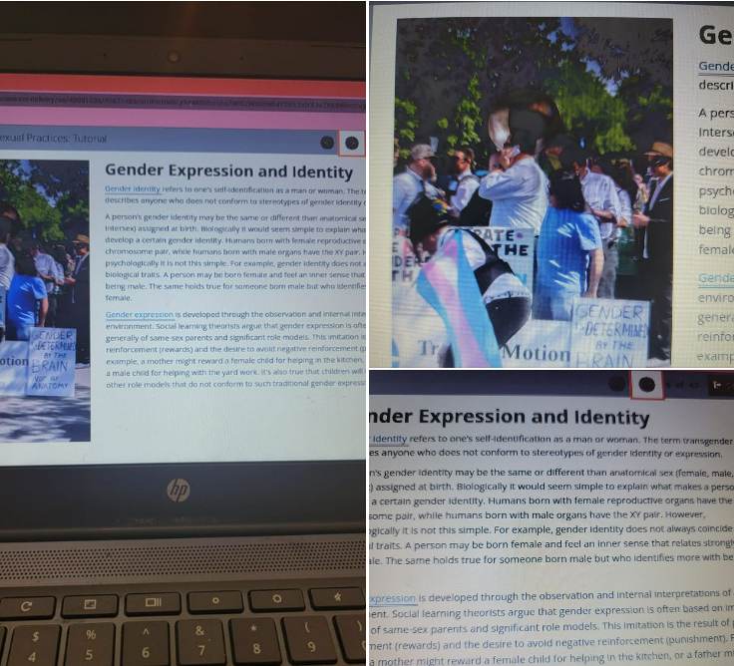
Northwest Stark County - 8th Grade Health Class.

Slide 3

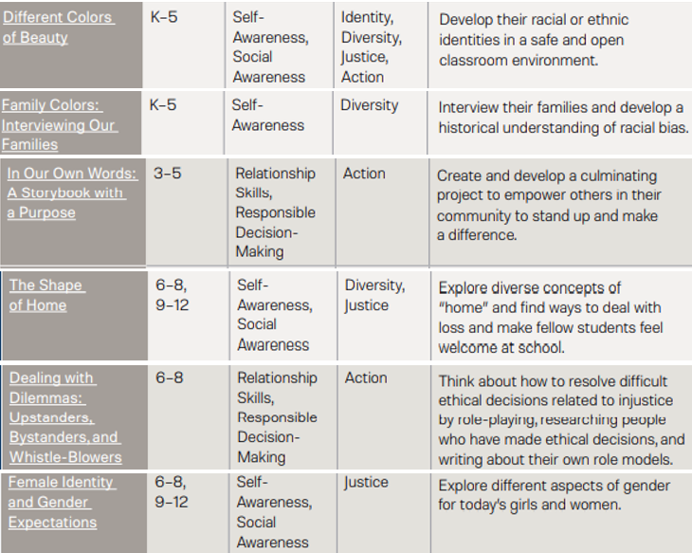
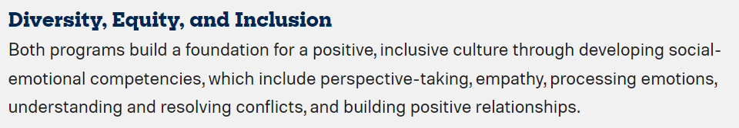
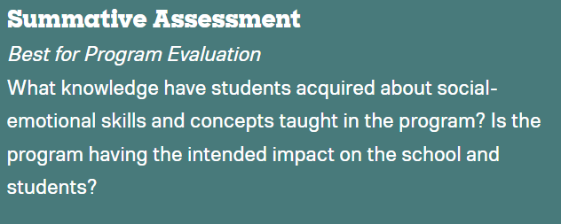
We’re committed to addressing racial injustice and helping you drive real change in your school communities. These resources will help you implement social-emotional learning (SEL) in a way that builds on students’ cultural assets, critically examines systems of power, and develops better ways of teaching, learning, and being. The Collaborative for Academic, Social, and Emotional Learning (CASEL) calls this transformative SEL. Engaging in this form of SEL is challenging—it pushes us to question long-standing beliefs, assumptions, and policies—but it is necessary to move toward a more just and equitable future.
Elementary School Curriculum | Second Step
Perry School District

Slide 4
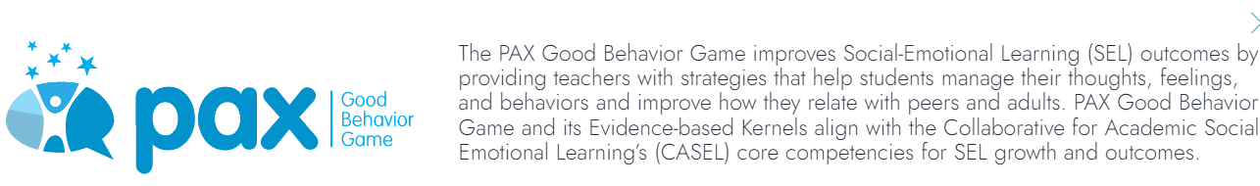
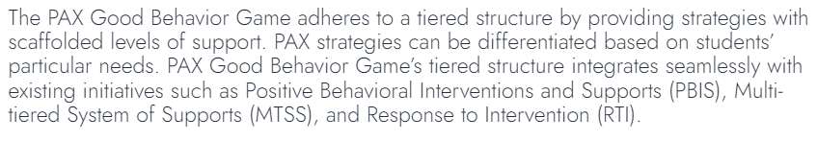
PBIS and SEL tool
Kernels and behavioral vaccines are simple, and they are not programs or curriculum in the conventional sense. This article presents examples of evidence-based kernels and behavioral vaccines that can be promoted easily across whole communities or states using social marketing principles. Widespread propagation of evidence-based kernels and behavioral vaccines could have a significant impact on communities and their prevention norms, providing low-cost alternatives and practical models for community psychology, public health, and policy makers. Behavioral kernels and vaccines can add needed precision to prevention science and community psychology.
-Dennis D. Embry, PAX President and Senior Scientist
LINK
Lake and Jackson use pax, could be in other schools as well.
PAX

Slide 5
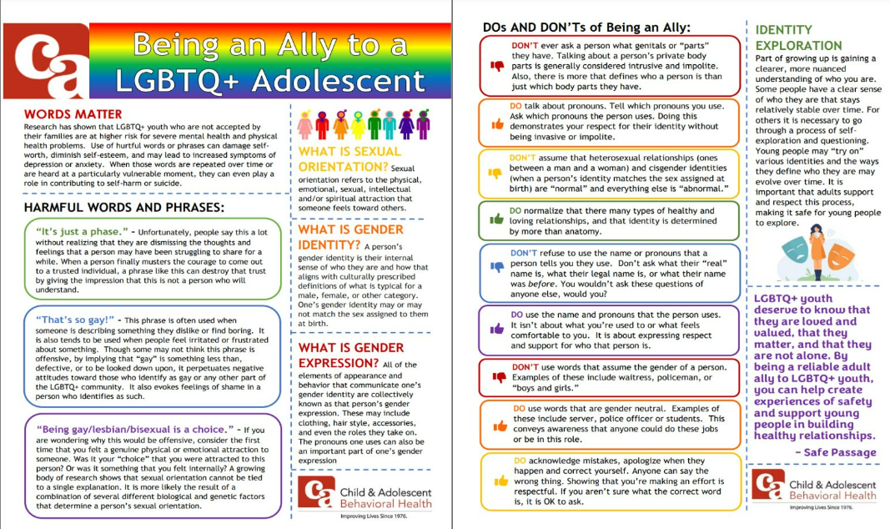
City School Districts C & A has agreements with Alliance City, Canton City and Massillon City schools to provide school-based consultation services within their school district. These agreements place C & A clinicians in the elementary, middle and high school setting. The school-based clinicians work on school premises.
County School Districts C & A has agreements with Lake Local, Marlington Local, Plain Local, Sandy Valley Local and Tuslaw Local schools to provide school-based consultation services within their school districts. Starting in August with the 2019 school year, These agreements place C & A clinicians in the elementary, middle and high school setting. The school-based clinicians working in the school buildings.

Slide 6
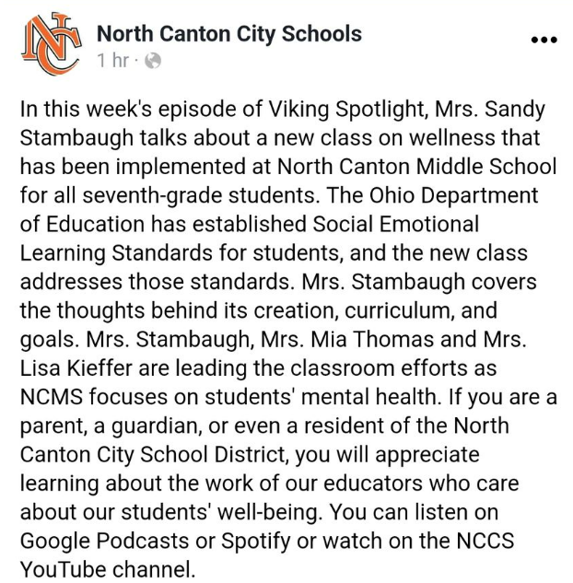
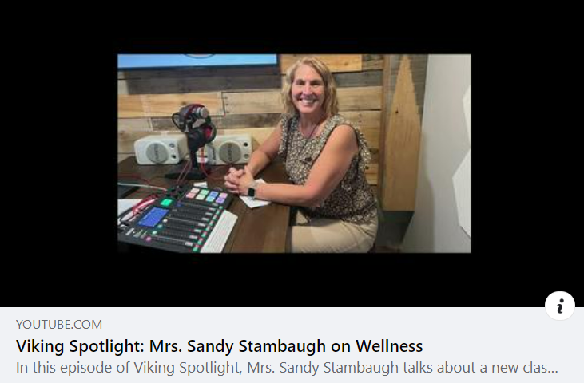
Viking Spotlight: Mrs. Sandy Stambaugh on Wellness - YouTube

